Slide 1
Capstone Project-3
Supervised ML on Company Bankruptcy Prediction (Classification)
- Soma Pavan Kumar(Pro Flex) - spkumar1998@gmail.com

Slide 2
Contents
1. Problem Statement
2. Introduction
3. Data Cleaning and Data Viz
4. Data Modelling and Implementation
5. Conclusion

Slide 3
Problem Statement
Prediction of bankruptcy is a phenomenon of increasing interest to firms who stand to lose money because on unpaid debts. Since computers can store huge dataset pertaining to bankruptcy making accurate predictions from them before hand is becoming important.
In this project you will use various classification algorithms on bankruptcy dataset to predict bankruptcies with satisfying accuracies long before the actual event

Slide 4
Introduction
The economic meltdown of 2008, initiated a conversation about market sustainability, and the tools that can be used to predict it. The need for better predictive models become apparent, in order to avoid such devastating events in the future.
Bankruptcy of companies and enterprises effects the financial market at multiple fronts, and hence the need to predict bankruptcy among companies by monitoring multiple variables takes on an added significance.
A better understanding of bankruptcy and the ability to predict it will impact affect the profitability of lending institutions worldwide

Slide 5
Variable Information
The Dataset we are working on has 96 Columns. Of which, 95 are variables(features) and the other is label(dependent Variable)
The Columns are named from X1 till X95 .
Some of the columns are:
X1 - ROA(C) before interest and depreciation before interest: Return On Total Assets(C)
X4 - Operating Gross Margin: Gross Profit/Net Sales
X20 - Cash Flow Per Share
X21 - Revenue Per Share (Yuan ¥): Sales Per Share
And many more…..

Slide 6
Data Wrangling
Data wrangling is the process of cleaning and unifying messy and complex data sets for easy access and analysis.
Our Dataset includes about 96 columns and about 6819 observations
Of the 96 columns only one target variable called “Bankruptcy?”

Slide 7
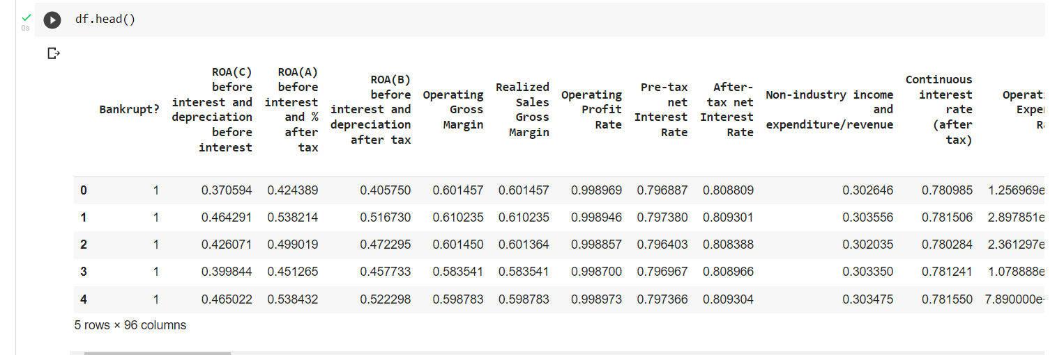
The snippet of Our dataset looks like:
The df.head() method shows us the first 5 rows of the Dataset.

Slide 8
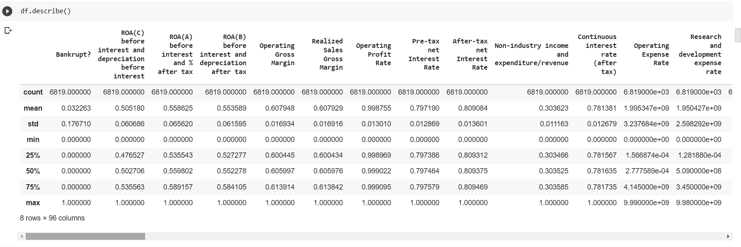
Let us look at some statistics of the Data
The Statistics of the data could be found out from an inbuilt function in pandas library called describe() .

Slide 9
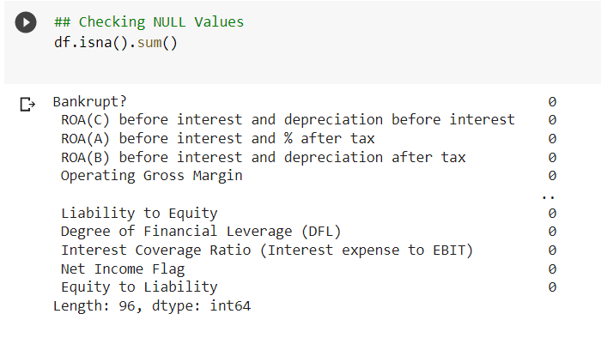
Checking for any NULL values in the whole Dataset
It is very evident that we don’t have any null values.
So, we can proceed with next steps

Slide 10
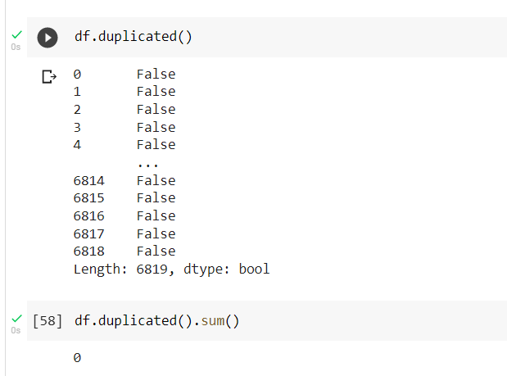
Checking for any Duplicate Values:
So, It is evident that there are no duplicate values in our whole dataset.

Slide 11
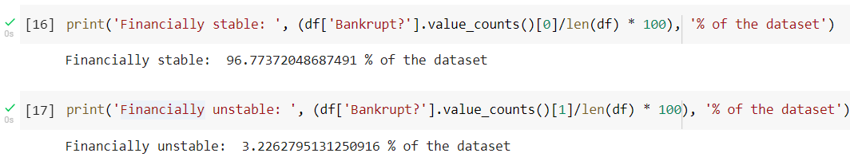
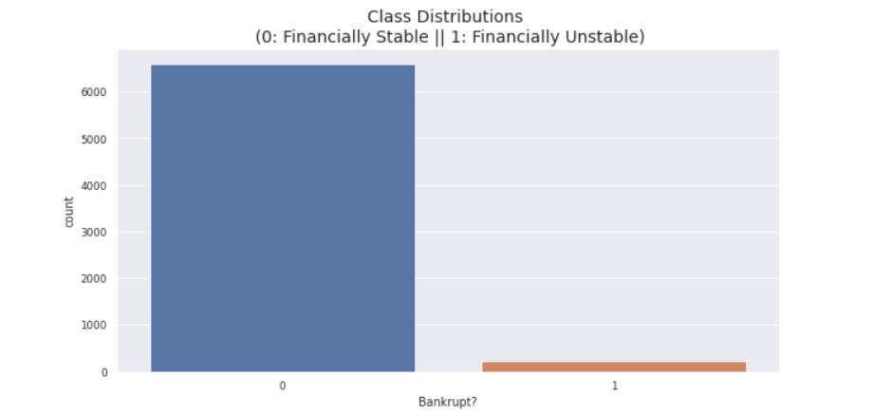
1. Checking the Distribution of the Target Variable
Lets begin with visualizations
As it can be seen, around 97% of the data (target Variable) is of Financially Stable and the other part is of Financially Unstable.

Slide 12
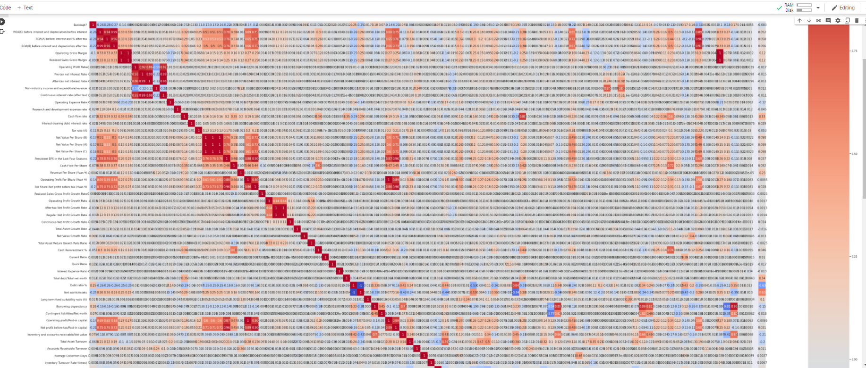
2. Lets plot the Correlations between the independent variables/features in the dataset
\.
As there are 65 features the Visualizations can get pretty difficult to understand and to show in a single slide
Here, we cannot show all the observations, but how much ever we can see, We can see some pretty high Correlations between the Features

Slide 13
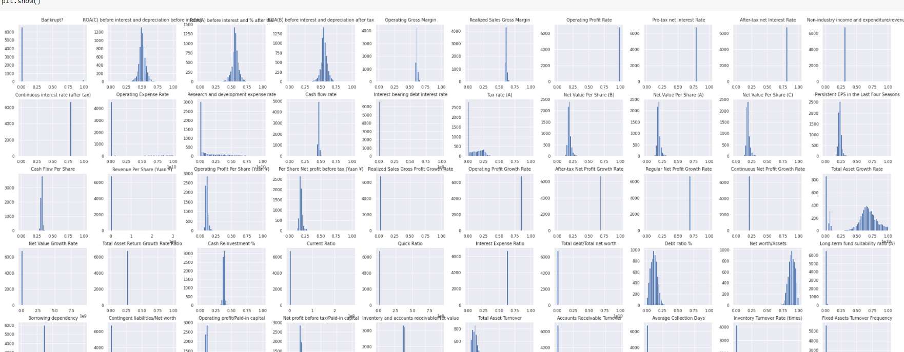
3. Data Distributions of all the variables
All the histograms cannot be shown in a single slide . So, these are some of the Distributions

Slide 14
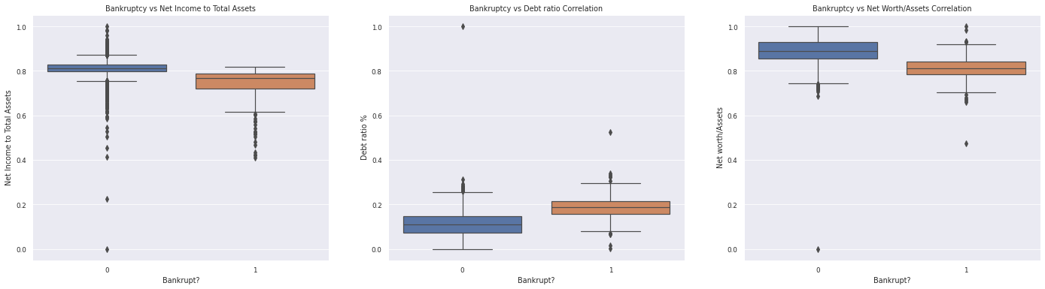
Some Correlations between the Variables using Box plot:

Slide 15
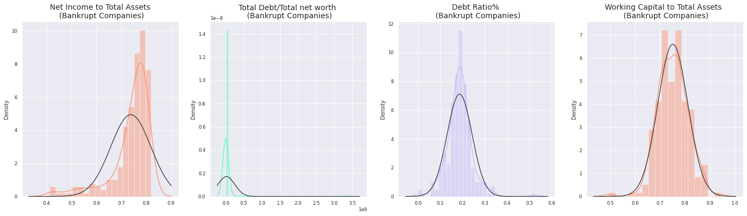
4. Plotting the feature distributions for close to bankruptcy companies(unstable Companies) after removing the outliers

Slide 16
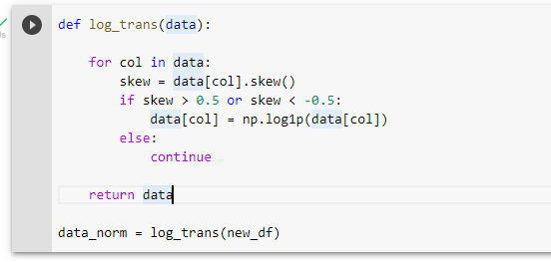
5. Let’s Do the Log Transformation on our Data
Log or Logarithmic Transformation is a data Transformation is a data transformation in which each variable is replaced with log of that variable
Log Transformation reduces the skewness present in the data .
It is done so that original data has to approximately follow Log-normal Distribution
The Piece of code which does the log transformation is shown below:

Slide 17
Data modelling
Data Modelling is the process of analyzing the data objects and their relationship to the other objects. It is used to analyze the data requirements that are required for the business processes.
Train test split
The procedure involves taking a dataset and dividing it into two subsets. The first subset is used to fit the model and is referred to as the training dataset. The second subset is not used to train the model; instead, the input element of the dataset is provided to the model, then predictions are made and compared to the expected values. This second dataset is referred to as the test dataset.

Slide 18
Lets implement Machine Learning Algorithms!
1. Logistic Regression :
Logistic regression is a statistical model that in its basic form uses a logistic Function to model a binary dependent variable, although many more complex extensions exist. In regression analysis, logistic regression (or logit regression) is estimating the parameters of a logistic model (a form of binary regression).
Mathematically, a binary logistic model has a dependent variable with two possible values, such as pass/fail which is represented by an indicator variable, where the two values are labeled "0" and "1".

Slide 19
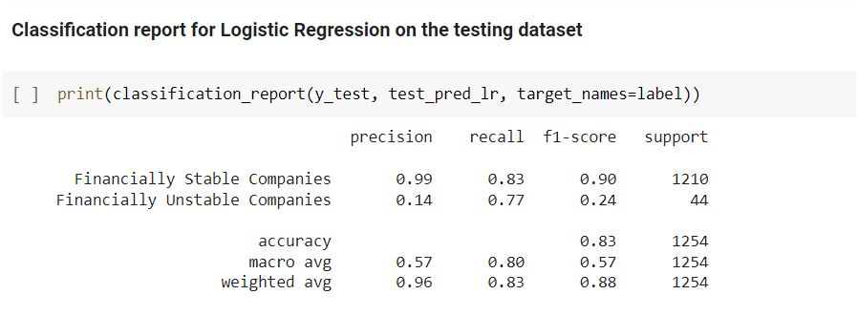
Results from Logistic Regression:
All the Accuracy Scores are shown below in this picture. Which gives us
Accuracy, Precision, Recall and F1-Score.

Slide 20
2. K-Nearest Neighbors (KNN) Classifier
K nearest neighbors classifier is a non-parametric supervised learning algorithm first developed by Evelyn Fix and Joseph Hodges in 1951.
It works by finding the distance between a query and all the examples in the data. For classification problems, a class label is assigned on the basis of a majority vote—i.e. the label that is most frequently represented around a given data point is used.
To which example the query is closest to is calculated using different metrics such as Euclidean distance, Manhattan distance, Minkowski distance and other metrics.

Slide 21
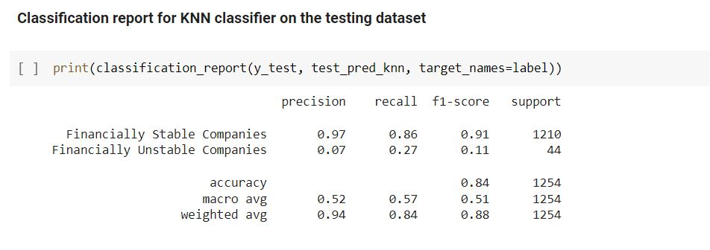
Results from K-Nearest Neighbors Classifier:

Slide 22
3. Naive Bayes Classifier (Gaussian)
Naive Bayes classification is an algorithm that is based on the Bayes’ Theorem. It is not a single algorithm but a family of algorithms where all of them share a common principle.
Naïve Bayes Classifier is one of the simple and most effective Classification algorithms which helps in building the fast machine learning models that can make quick predictions.
It is a probabilistic classifier, which means it predicts on the basis of the probability of an object. Naive Bayes classifier is also used for text classification algorithm.

Slide 23
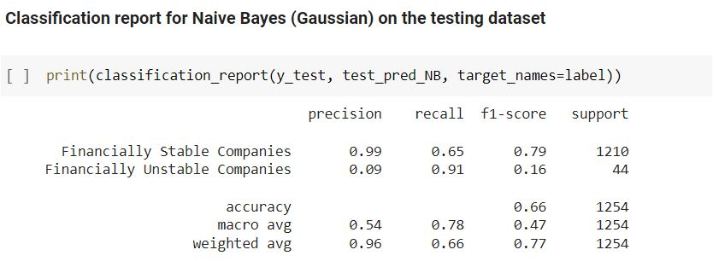
Results from Naive Bayes (Gaussian)

Slide 24
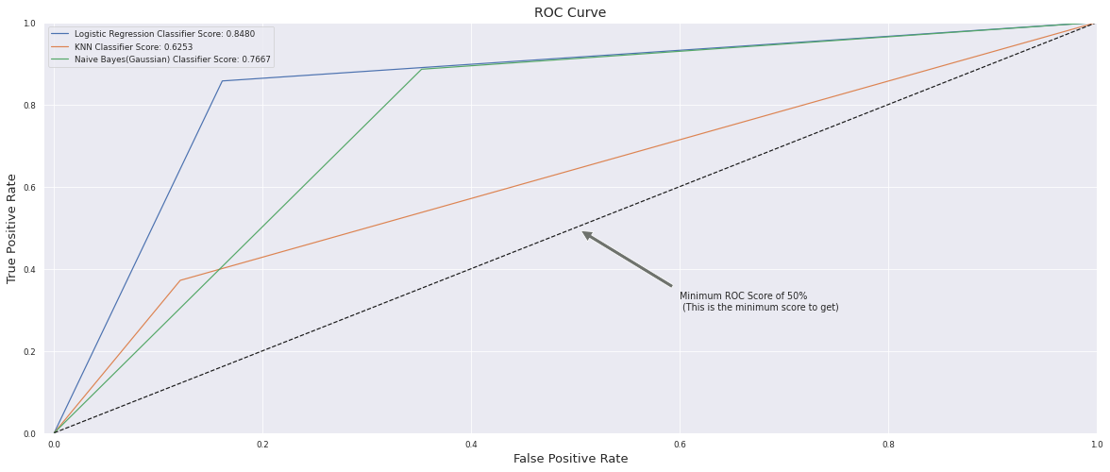
Plotting AUC-ROC curve
AUC - ROC curve is a performance measurement for the classification problems at various threshold settings. ROC is a probability curve and AUC represents the degree or measure of separability. It tells how much the model is capable of distinguishing between classes.

Slide 25
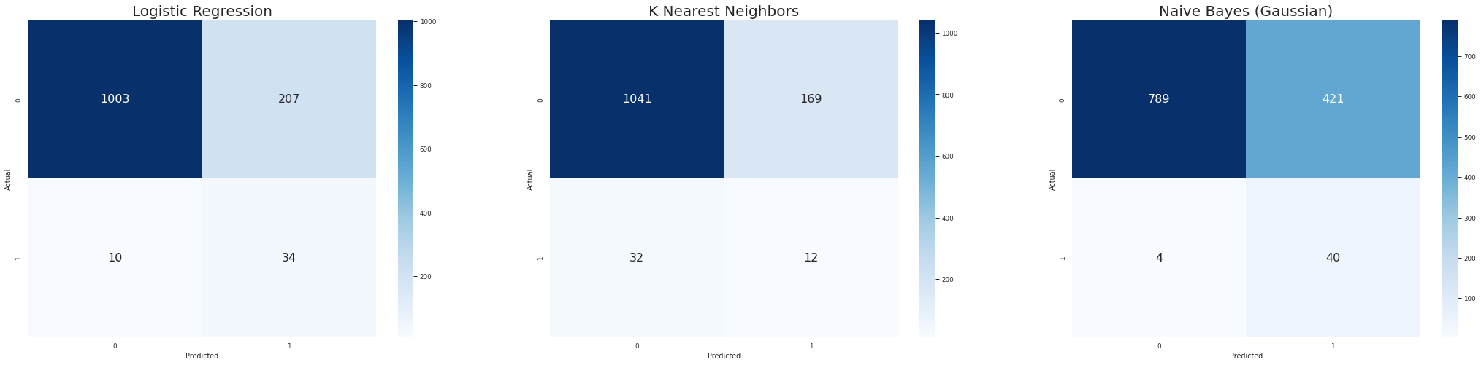
Confusion Matrix for each classifier (on the testing dataset)

Slide 26
Conclusion:
The Experiment I chose is to predict if a company is going bankrupt according to the given features.
The dataset has 65 features on offer .
We applied 4 Machine Learning Algorithms namely :
1. Logistic Regression
2. K-Nearest Neighbors
3. Naive Bayes (Gaussian)
according to the f1-scores and the Accuracy metrics, KNN is the best metric to choose for further predictions.

Slide 27
But according to AUC-ROC (Area Under the Curve – Receiver Operating Characteristics) says the larger the number, the greater the model.
So, according to AUC-ROC, Logistic Regression stands first with a score of 0.84
Nevertheless, in this case, the best decision is to use Logistic regression because it can better recognize the minority class even misclassifying some not close to bankruptcy companies as close to bankruptcy.
Also the parameters that contribute to bankruptcy of a company are also external such as decisions taken by the CEO of the company and dwindling workforce and so on. Which can neither be calculated nor predicted.

